Slide 1
Linear Regression and the Bias Variance Tradeoff
Guest Lecturer
Joseph E. Gonzalez
slides available here: http://tinyurl.com/reglecture

Slide 2
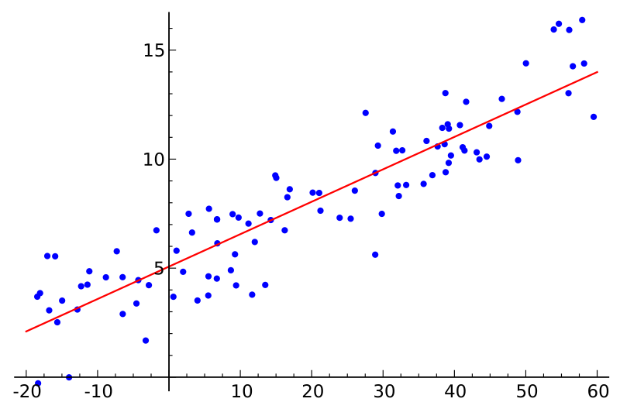
Simple Linear Regression
Y
X
Response
Variable
Covariate
Linear Model:
Slope
Intercept (bias)

Slide 3
Motivation
One of the most widely used techniques
Fundamental to many larger models
Generalized Linear Models
Collaborative filtering
Easy to interpret
Efficient to solve

Slide 4
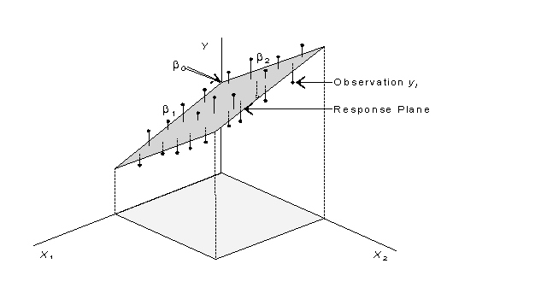
Multiple Linear Regression

Slide 5
The Regression Model
For a single data point (x,y):
Joint Probability:
Independent Variable
(Vector)
Response Variable
(Scalar)
x
Observe:
(Condition)
x
y
Discriminative
Model

Slide 6


Slide 7
The Linear Model
Vector of
Parameters
Vector of
Covariates
+ b
Scalar
Response
Real Value
Noise
Noise Model:
Linear Combination of Covariates
What about bias/intercept term?
Then redefine p := p+1 for notational simplicity

Slide 8
Conditional Likelihood p(y|x)
Conditioned on x:
Conditional distribution of Y:
Constant
Normal Distribution
Mean
Variance

Slide 9
Parameters and Random Variables
Parameters
Conditional distribution of y:
Bayesian: parameters as random variables
Frequentist: parameters as (unknown) constants

Slide 10
So far …
Y
I’m lonely
*
X₂
X₁

Slide 11
Independent and Identically Distributed (iid) Data
For n data points:
Plate Diagram
Independent Variable
(Vector)
Response Variable
(Scalar)
x_{i}
y_{i}

Slide 12
Joint Probability
x_{i}
y_{i}
For n data points independent and identically distributed (iid):

Slide 13
Rewriting with Matrix Notation
Represent data as:
Covariate (Design)
Matrix
Response
Vector
n
n
Assume X has rank p
(not degenerate)
p
1

Slide 14
Rewriting with Matrix Notation
Rewriting the model using matrix operations:
= +
p
n
n
n
1
1
p
Notes:
\mathcal{L}(\mathcal{D}; \theta, \sigma^2)
& = \frac{1}{\sigma^n (2 \pi)^{\frac{n}{2}}} \exp\left( - \frac{1}{2 \sigma^2 } \sum_{i=1}^n (y_i - \theta^T x_i)^2 \right) \\

Slide 15
Estimating the Model
Given data how can we estimate θ?
Construct maximum likelihood estimator (MLE):
Derive the log-likelihood
Find θ_{MLE} that maximizes log-likelihood
Analytically: Take derivative and set = 0
Iteratively: (Stochastic) gradient descent

Slide 16
Joint Probability
x_{i}
x_{i}
y_{i}
For n data points:
“1”
Discriminative
Model

Slide 17
Defining the Likelihood
x_{i}
y_{i}

Slide 18
Maximizing the Likelihood
Want to compute:
To simplify the calculations we take the log:
which does not affect the maximization because log is a monotone function.

Slide 19
Take the log:
Removing constant terms with respect to θ:
Monotone Function
(Easy to maximize)
Notes:
P(\{Y\}_{i=1}^n | \{X\}_{i=1}^n)
& = \prod_{i=1}^n P(Y_i | X_i) \\
& \propto \prod exp\left( - \frac{(y - \theta^T x)^2}{2 \sigma^2 } \right)

Slide 20
Want to compute:
Plugging in log-likelihood:
Notes:
P(\{Y\}_{i=1}^n | \{X\}_{i=1}^n)
& = \prod_{i=1}^n P(Y_i | X_i) \\
& \propto \prod exp\left( - \frac{(y - \theta^T x)^2}{2 \sigma^2 } \right)

Slide 21
Dropping the sign and flipping from maximization to minimization:
Gaussian Noise Model → Squared Loss
Least Squares Regression
Minimize Sum (Error)²
Notes:
P(\{Y\}_{i=1}^n | \{X\}_{i=1}^n)
& = \prod_{i=1}^n P(Y_i | X_i) \\
& \propto \prod exp\left( - \frac{(y - \theta^T x)^2}{2 \sigma^2 } \right)

Slide 22
Pictorial Interpretation of Squared Error
y
x

Slide 23
Maximizing the Likelihood (Minimizing the Squared Error)
Convex Function
Slope = 0
Take the gradient and set it equal to zero
Notes:
P(\{Y\}_{i=1}^n | \{X\}_{i=1}^n)
& = \prod_{i=1}^n P(Y_i | X_i) \\
& \propto \prod exp\left( - \frac{(y - \theta^T x)^2}{2 \sigma^2 } \right)

Slide 24
Minimizing the Squared Error
Taking the gradient
Chain Rule →

Slide 25
Rewriting the gradient in matrix form:
To make sure the log-likelihood is convex compute the second derivative (Hessian)
If X is full rank then X^{T}X is positive definite and therefore θ_{MLE} is the minimum
Address the degenerate cases with regularization
Notes:
http://www.cs.berkeley.edu/~jduchi/projects/matrix_prop.pdf

Slide 26
Setting gradient equal to 0 and solve for θ_{MLE}:
Normal
Equations
(Write on
board)
n
p
n
1
-1
p
=
Notes:
http://www.cs.berkeley.edu/~jduchi/projects/matrix_prop.pdf

Slide 27
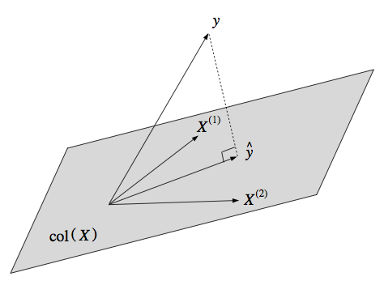
Geometric Interpretation
View the MLE as finding a projection on col(X)
Define the estimator:
Observe that Ŷ is in col(X)
linear combination of cols of X
Want to Ŷ closest to Y
Implies (Y-Ŷ) normal to X

Slide 28
Connection to Pseudo-Inverse
Moore-Penrose Psuedoinverse
Generalization of the inverse:
Consider the case when X is square and invertible:
Which implies θ_{MLE}= X⁻¹ Y the solution to X θ = Y when X is square and invertible

Slide 29
Computing the MLE
Not typically solved by inverting X^{T}X
Solved using direct methods:
Cholesky factorization:
Up to a factor of 2 faster
QR factorization:
More numerically stable
Solved using various iterative methods:
Krylov subspace methods
(Stochastic) Gradient Descent
or use the built-in solver in your math library.
R: solve(Xt %*% X, Xt %*% y)
http://www.seas.ucla.edu/~vandenbe/103/lectures/qr.pdf

Slide 30
Cholesky Factorization
C
d
Compute symm. matrix
Compute vector
Cholesky Factorization
L is lower triangular
Forward subs. to solve:
Backward subs. to solve:
Connections to graphical model inference:
http://ssg.mit.edu/~willsky/publ_pdfs/185_pub_MLR.pdf and http://yaroslavvb.blogspot.com/2011/02/junction-trees-in-numerical-analysis.html with illustrations

Slide 31
Solving Triangular System
A₁₁x₁
A₁₁
A₁₂x₂
A₁₂
A₁₃x₃
A₁₃
A₁₄x₄
A₁₄
x₁
b₁
A₂₂
A₂₃
A₂₄
x₂
b₂
=
*
A₃₃
A₃₄
x₃
b₃
A₄₄
x₄
b₄
Bonus Content

Slide 32
Solving Triangular System
A₁₁x₁
A₁₂x₂
A₁₃x₃
A₁₄x₄
b₁
x₁=b₁-A₁₂x₂-A₁₃x₃-A₁₄x₄
A₁₁
A₂₂x₂
A₂₃x₃
A₂₄x₄
b₂
x₂=b₂-A₂₃x₃-A₂₄x₄
A₂₂
A₃₃x₃
A₃₄x₄
b₃
x₃=(b₃-A₃₄x₄)
A₃₃
A₄₄x₄
b₄
Bonus Content
x₄=b₄ /A₄₄

Slide 33
Distributed Direct Solution (Map-Reduce)
Distribution computations of sums:
Solve system C θ_{MLE} = d on master.
p
p
1
p

Slide 34
Gradient Descent: What if p is large? (e.g., n/2)
The cost of O(np²) = O(n³) could by prohibitive
Solution: Iterative Methods
Gradient Descent:
For τ from 0 until convergence
Learning rate

Slide 35
Gradient Descent Illustrated:
Slope = 0
Convex Function

Slide 36
Gradient Descent: What if p is large? (e.g., n/2)
The cost of O(np²) = O(n³) could by prohibitive
Solution: Iterative Methods
Gradient Descent:
Can we do better?
For τ from 0 until convergence
Estimate of the Gradient

Slide 37
Stochastic Gradient Descent
Construct noisy estimate of the gradient:
Sensitive to choice of ρ(τ) typically (ρ(τ)=1/τ)
Also known as Least-Mean-Squares (LMS)
Applies to streaming data O(p) storage
For τ from 0 until convergence
1) pick a random i
2)

Slide 38
Fitting Non-linear Data
What if Y has a non-linear response?
Can we still use a linear model?

Slide 39
Transforming the Feature Space
Transform features x_{i}
By applying non-linear transformation ϕ:
Example:
others: splines, radial basis functions, …
Expert engineered features (modeling)

Slide 40
Under-fitting
Over-fitting

Slide 41
Really Over-fitting!
Errors on training data are small
But errors on new points are likely to be large

Slide 42
What if I train on different data?
Low Variability:
High Variability

Slide 43
Bias-Variance Tradeoff
So far we have minimized the error (loss) with respect to training data
Low training error does not imply good expected performance: over-fitting
We would like to reason about the expected loss (Prediction Risk) over:
Training Data: {(y₁, x₁), …, (y_{n}, x_{n})}
Test point: (y*, x*)
We will decompose the expected loss into:

Slide 44
Define (unobserved) the true model (h):
Completed the squares with:
Assume 0 mean noise
[bias goes in h(x*)]
Expected Loss
a
b

Slide 45
Define (unobserved) the true model (h):
Completed the squares with:
Expected Loss
Substitute defn. y* = h* + e*
Notes:
----- Meeting Notes (2/25/14 11:04) -----
Noise assumption is zero mean.

Slide 46
Define (unobserved) the true model (h):
Completed the squares with:
Minimum error is governed by the noise.
Expected Loss
Noise Term
(out of our control)
☹
Model Estimation Error
(we want to minimize this)
Expand

Slide 47
Expanding on the model estimation error:
Completing the squares with

Slide 48
Expanding on the model estimation error:
Completing the squares with

Slide 49
Expanding on the model estimation error:
Completing the squares with
Tradeoff between bias and variance:
Simple Models: High Bias, Low Variance
Complex Models: Low Bias, High Variance
(Bias)²
Variance

Slide 50
Summary of Bias Variance Tradeoff
Expected Loss
Noise
(Bias)²
Variance
Choice of models balances bias and variance.
Over-fitting ➔ Variance is too High
Under-fitting ➔ Bias is too High

Slide 51
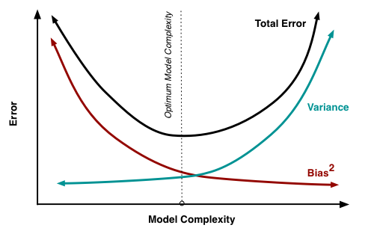
Bias Variance Plot
Image from http://scott.fortmann-roe.com/docs/BiasVariance.html
Notes:
Image

Slide 52
Analyze bias of
Assume a true model is linear:
Substitute MLE
Plug in definition of Y
Expand and cancel
Assumption:
is unbiased!

Slide 53
Analyze Variance of
Assume a true model is linear:
Use property of scalar: a² = a a^{T}
Substitute MLE + unbiased result
Plug in definition of Y
Expand and cancel

Slide 54
Analyze Variance of
Use property of scalar: a² = a a^{T}

Slide 55
Consequence of Variance Calculation
Higher Variance
Lower Variance
Figure from http://people.stern.nyu.edu/wgreene/MathStat/GreeneChapter4.pdf

Slide 56
Analyze Variance of
Assume a true model is linear:
Next: use matrix variance identity
Substitute MLE + unbiased result
Plug in definition of Y
Expand and cancel

Slide 57
Analyze Variance of
Define:
Use matrix variance identity:
If we assume x is iid N(0, 1):

Slide 58
Deriving the final identity
Assume x_{i} and x* are N(0,1)

Slide 59
Summary
Least-Square Regression is Unbiased:
Variance depends on:
Number of data-points n
Dimensionality p
Not on observations Y
Notes:
----- Meeting Notes (2/25/14 11:04) -----
Mention linear assumption in true model

Slide 60
Gauss-Markov Theorem
The linear model: has the minimum variance among all unbiased linear estimators
Note that this is linear in Y
BLUE: Best Linear Unbiased Estimator

Slide 61
Summary
Introduced the Least-Square regression model
Maximum Likelihood: Gaussian Noise
Loss Function: Squared Error
Geometric Interpretation: Minimizing Projection
Derived the normal equations:
Walked through process of constructing MLE
Discussed efficient computation of the MLE
Introduced basis functions for non-linearity
Demonstrated issues with over-fitting
Derived the classic bias-variance tradeoff
Applied to least-squares model

Slide 62


Slide 63
Additional Reading I found Helpful
http://www.stat.cmu.edu/~roeder/stat707/lectures.pdf
http://people.stern.nyu.edu/wgreene/MathStat/GreeneChapter4.pdf
http://www.seas.ucla.edu/~vandenbe/103/lectures/qr.pdf
http://www.cs.berkeley.edu/~jduchi/projects/matrix_prop.pdf

